Slide 1


Expanding Security Horizons: SIMD-Based Threats
AnDRII Mytroshyn

Slide 2
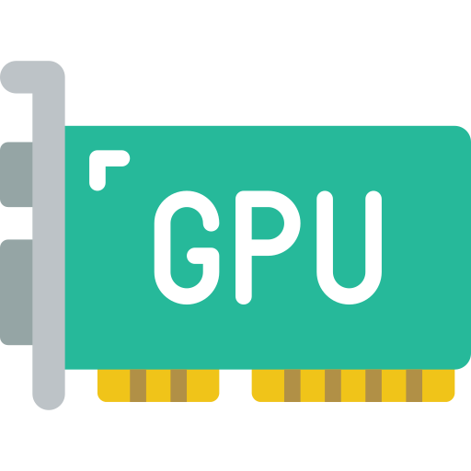
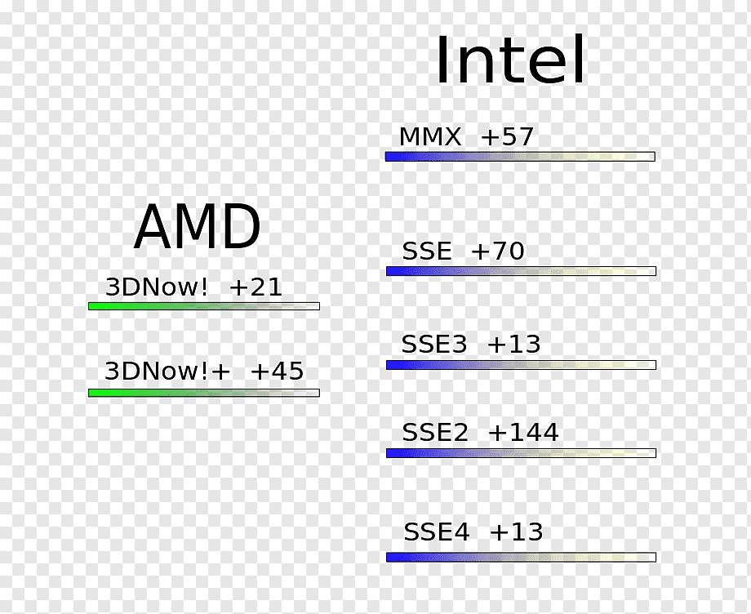


Where SIMD used

Slide 3
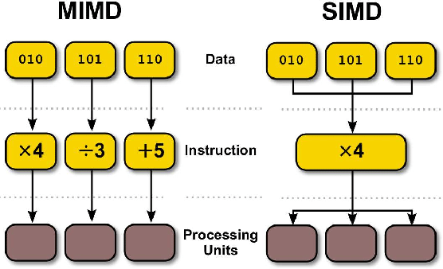
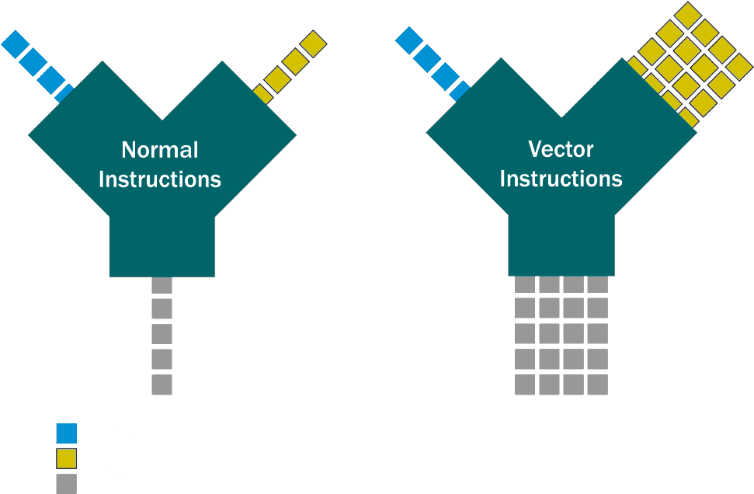


What is SIMD

Slide 4
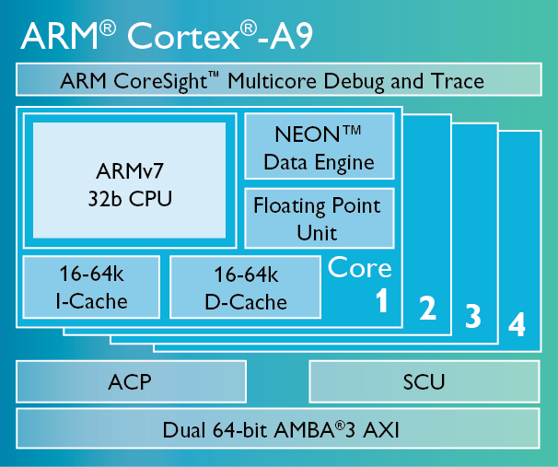
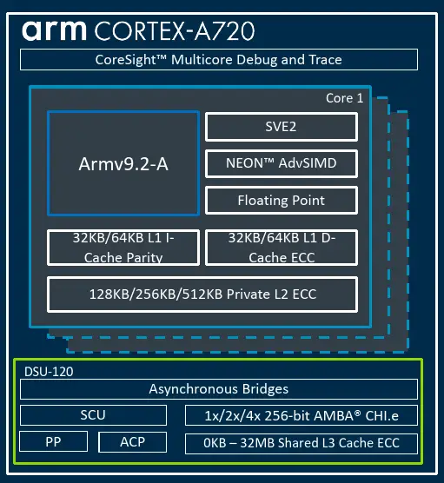
Why SIMD ?

Slide 5
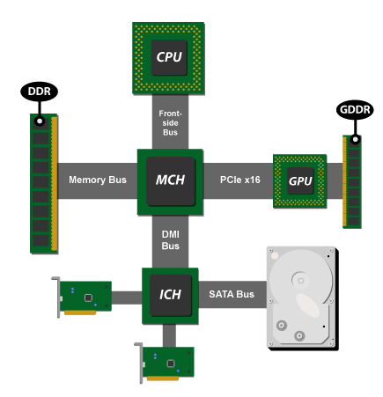
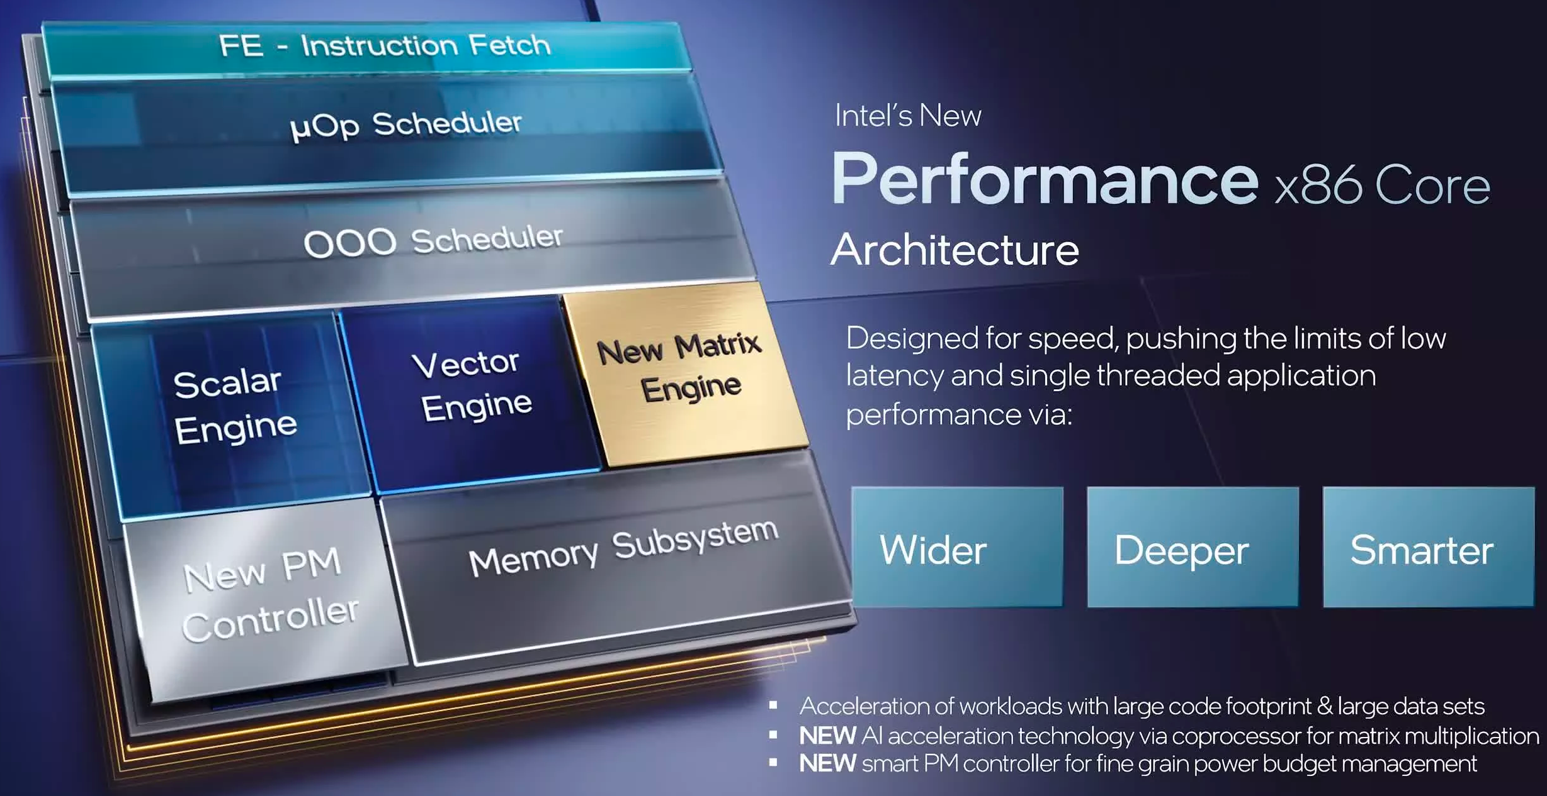
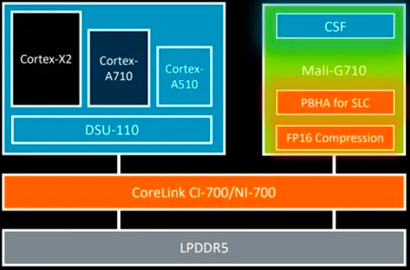
Why SIMD ?
Intel lays out multi-chip architecture plans: 12th-gen Core

Slide 6

Exhaustion Attack
A CPU Exhaustion Attack, also known as a CPU Resource Exhaustion Attack, is a type of cyberattack in which an attacker attempts to consume or deplete a computer system's Central Processing Unit (CPU) resources to the point where the system becomes unresponsive or unusable. This attack aims to overwhelm the CPU with excessive computational tasks or resource-intensive operations, causing legitimate processes and applications to slow down or crash.

Slide 7
Observed issues
Platform | Test case | Result | Problem
Nvidia GPU | Process big image with CUDA | BSOD or display driver restart | OS couldn’t contact with GPU and restart it
Arm | Calculating shader with some edge value on R-Car M2 | Performance decrease for CPU and GPU | Wrong implementation on driver level
Arm Neon | Copying date, aka memcpy, on R-Car H2/M2, with CPU usage | Additional overheat, and CPU instability | Wrong implementation on driver level
Any device | Executing OpenCL application with specific call | Application crashes, access to wrong memory | Wrong implementation on driver level

Slide 8
Issues from internet
LeftoverLocals: Listening to LLM responses through leaked GPU local memory, 01/16/2024
GPUs from all major suppliers are vulnerable to new pixel-stealing attack, 9/26/2023
GPU issues on cve.mitre.org
'Downfall' Bug in Billions of Intel CPUs Reveals Major Design Flaw, 9/9/2023

Slide 9
Q&A

